Slide 1
Progress on V2I Resource Allocation Model
Summer 2018

Slide 2
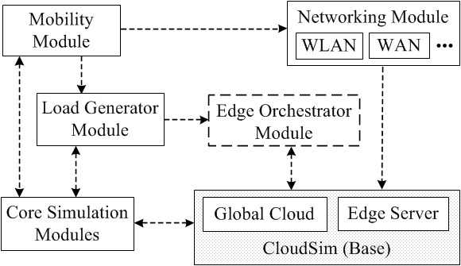
EdgeCloudSim
Suggested by a reviewer.

Slide 3
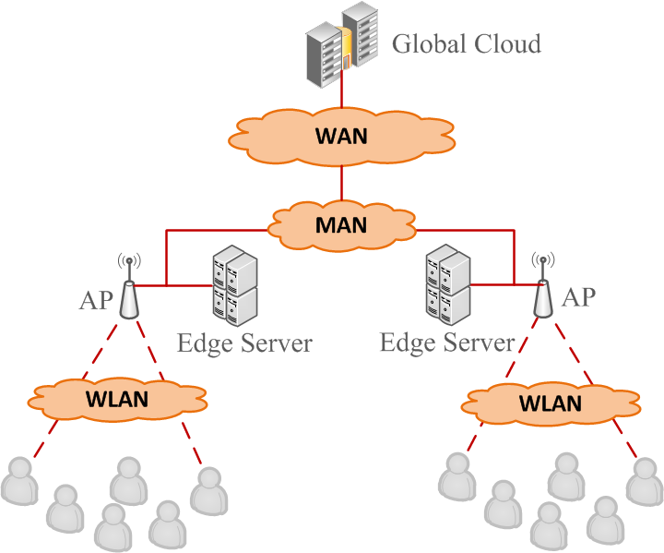
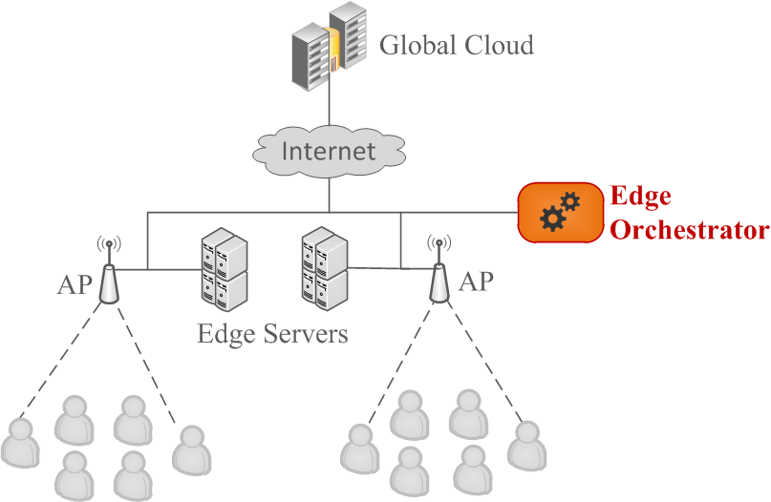
Networking and the Load Balancer

Slide 4
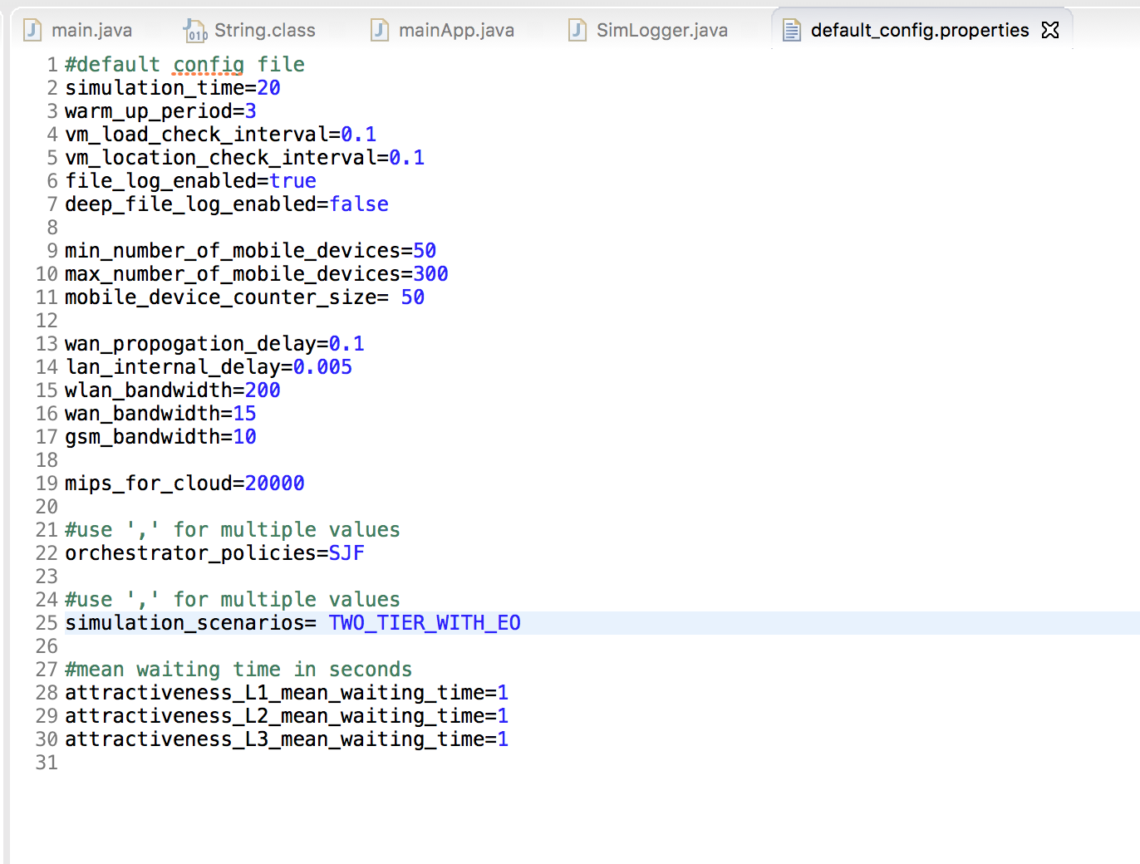
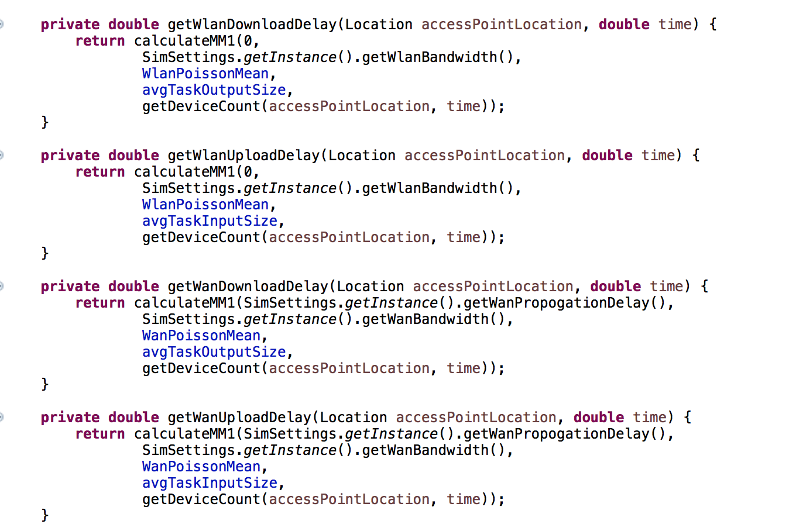
Delays
Oversimplified various delays
Solved in EdgeCloudSim. wan_propogation delay and lan_internal delay are set trough the configuration file and utilized in Network Model to calculate Upload and Download delay.

Slide 5
Real world vehicular Base Stations
Savari RSUs
1) 1 GB DRAM, 8 GB Flash, 2 cores, 2 VMs
2) 2 GB DRAM, 8 GB Flash, 4 cores, 2 VMs
Scaled up the simulation:
- 14 Edge Devices
- 7 Edge Devices with 1 GB DRAM
- 7 Edge Devices with 2 GB DRAM

Slide 6
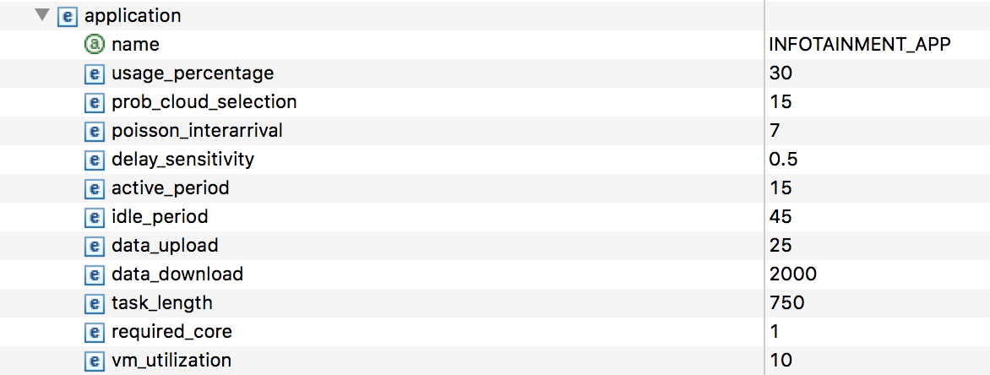
Applications
Using default apps provided by the EdgeCloudSim (4 types)
Heavy_comp, Health_app, Augm_reality, Infot_App

Slide 7
Simulation changes
Matrix Updates every 10 % of the simulation.
Scaled up for experiments to real world situations: from 50 to 300 vehicles generating up to 18000 tasks.
Locations implemented => the direction of movement can be easily implemented.
The tasks have the sensitivity, so we can consider both delay tolerant and intolerant tasks.

Slide 8
Problem
Impossible to immediately reflect the delay, created by current tasks waiting in the queue, on the matrix and hence, on probability.
As a result, in fact non-promising BSs are still have a good probability and are assigned way more tasks than they can handle.
Resolved by using VM utilization model during the decision-making process.

Slide 9
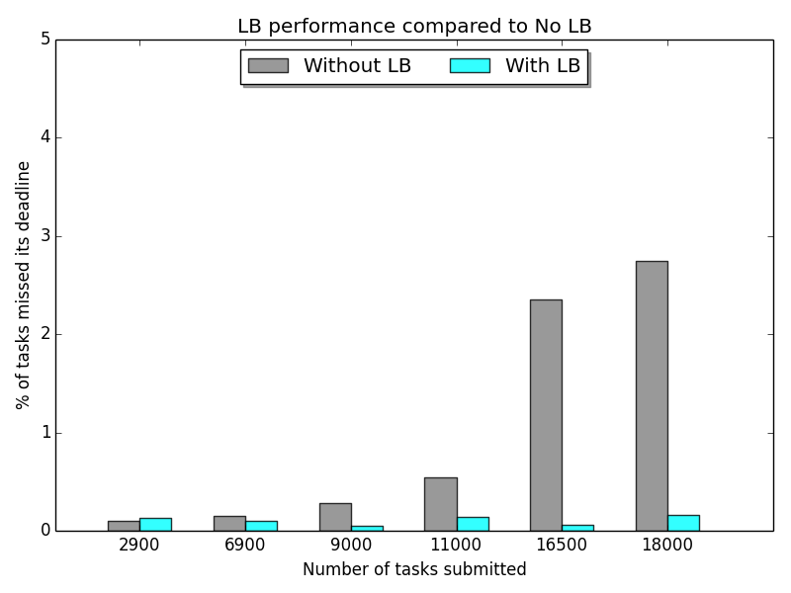
First results of the working algorithm

Slide 10
Future work
Testing the simulation under various conditions
Implementing Heterogeneity
Implementing the Direction of Movement
Implementing Sensitivity and the Cloud

